Slide 1
Axti.me Roles
By Isaac Acks v1.1
01/19/2018

Slide 2
Agenda
Live Results
Announcer
Car Queuer
Modifying Queue
Inserting New Driver
Cone Counter
Add Penalty
Registration
Registering a known member
Registering a new member
Request to change Number or Class
Driver Checkin
Number/Class conflict
Time Keeper
Troubleshooting
End of the Day

Slide 3
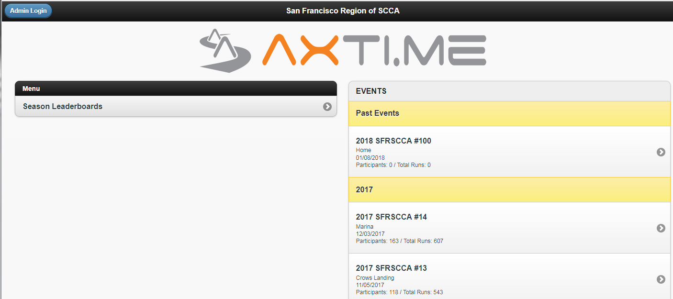
Home Page
First page when loading up 127.0.0.1 on browser

Slide 4
Live Results
For people to check on phones or other laptops connected to local wifi

Slide 5
Live Results
From home page, click on today’s event
Click “Results”
Notes:
No login required

Slide 6
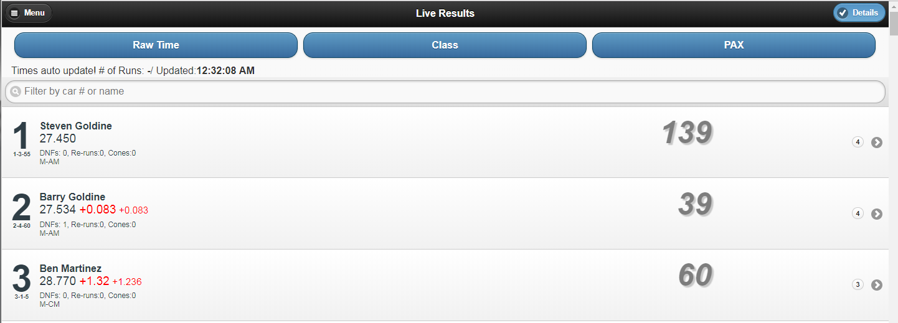
Live Results

Slide 7
Announcer
Unofficial Time Screamer

Slide 8
Announcer
From home page, click on today’s event
Click “Announcer”
Notes:
No login required

Slide 9
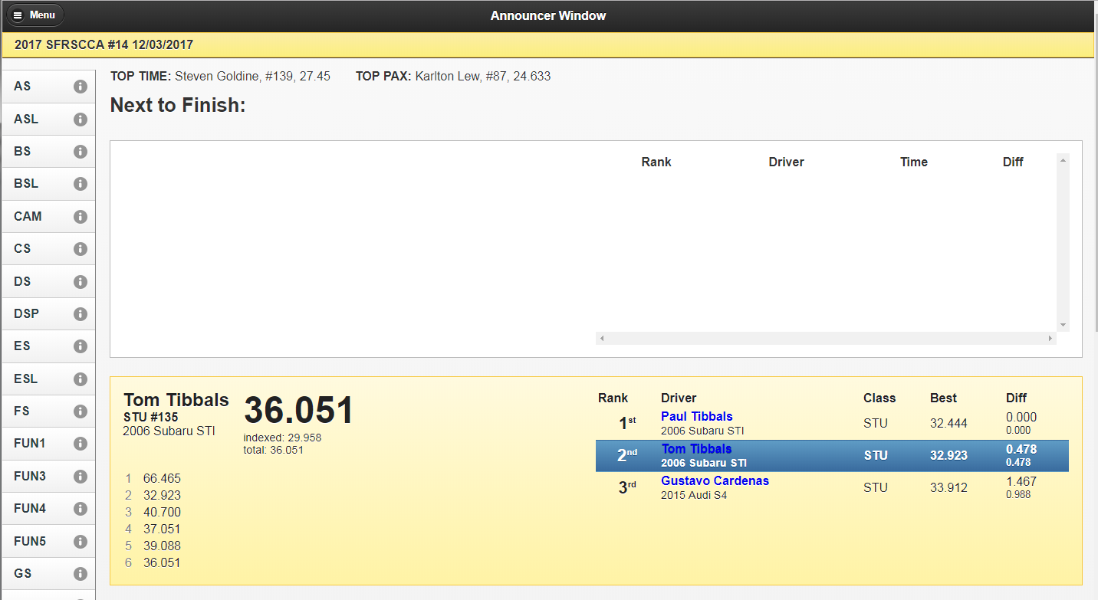
Announcer
Notes:
Whenever someone fixes a time on time keeper, that will get pushed here too. Important to note that what shows here is irrelevant to order of cars finishing. Only TIME KEEPER matters

Slide 10
Car Queuer
Gate Keeper

Slide 11
Car Queuer
From home page, click on today’s event
Click “Role Login” on top right and login as either Event Admin or Car Queuer
If Event Admin, click on “Car Queuer”
Notes:
Pref to just login as Event Admin
Reload this webpage between every rungroup or if someone was added to the current group in the middle

Slide 12
Car Queuer – Main Interface
Red Circle – Position of Next Insert
Green Circle – How to move or remove driver from queue
Orange Circle – How to add next car
Notes:
Red Circle – when it’s green, it shows where the next car will get inserted. Default is Last in Line. Click the bar to change where you want next car.
Green Circle – Up/down arrow moves driver up/down queue. X removes driver from queue.
Orange Circle – After you decide where next car should go, click to add driver

Slide 13
Car Queuer – Inserting Cars
Notes:
Just start typing number to get results. If only one driver, queuer will auto add it instead of giving you a list

Slide 14
Cone counter
Punishing Poor Driving

Slide 15
Cone Counter
From home page, click on today’s event
Click “Role Login” on top right and login as either Event Admin or Cone Counter
If Event Admin, click on “Cone Counter”

Slide 16
Cone Counter
Click on person who you want to penalize
Notes:
Blue is a driver who finished. White is still on course or in queue. No rhyme or reason for how cars are placed.

Slide 17
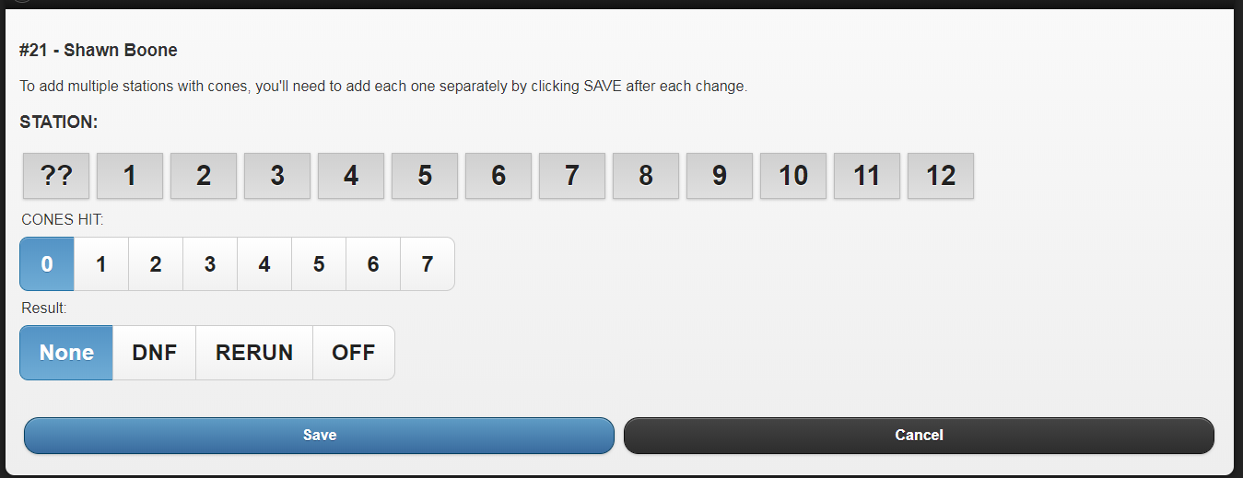
Cone Counter
Click appropriate penalty and then “Save”
Can undo a mistake by clicking person again, removing penalty, and saving
Notes:
Station irrelevant

Slide 18
Registration

Slide 19
Registration
From home page, click on today’s event
Click “Role Login” on top right and login as either Event Admin or Registration
If Event Admin, click on “Registration”
Notes:
Driver Check-In is for prereg only. I like to open it in a 2nd tab

Slide 20
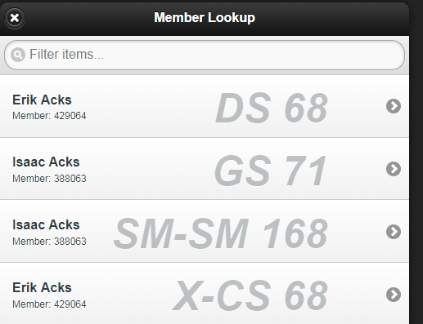
Registration – Known Member
Notes:
NO changes to class or number
Start typing name to narrow down results
If want to change, you need to make a new entry or tell them they forfeit their current class/number combo

Slide 21
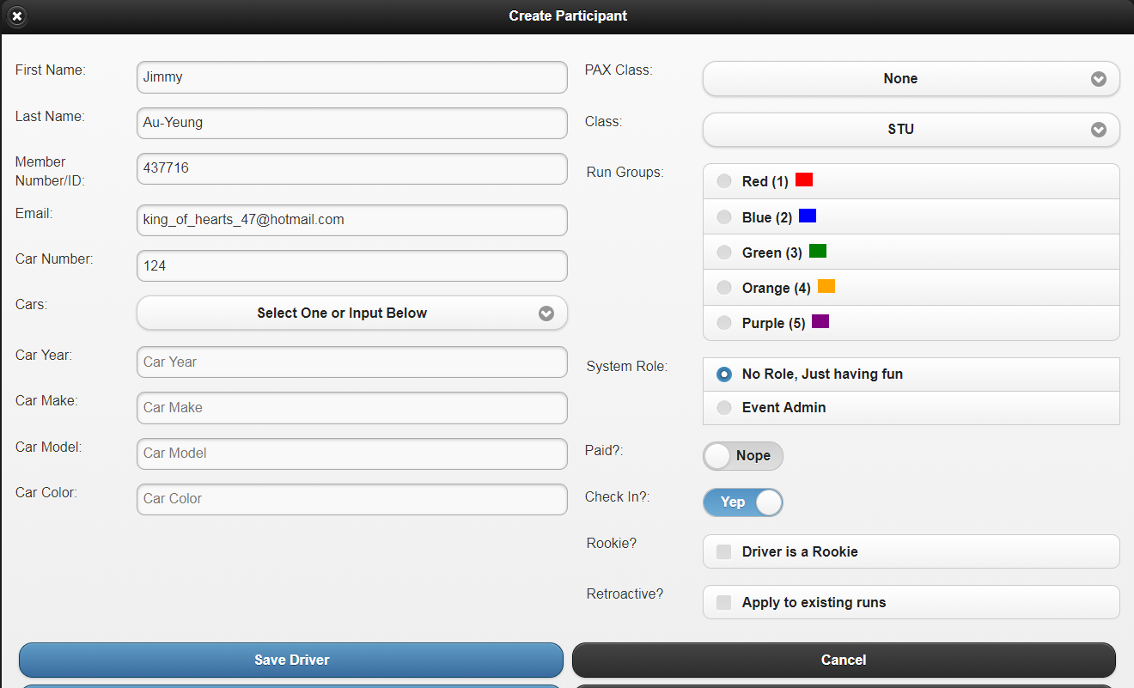
Registration – Known Member
Notes:
NO CHANGES TO CLASS OR NUMBER unless just changing the class in an indexed class. Like SM-SMF can be changed to SM-SM w/o any damage
Make sure a car is selected via drop down or enter new one
Slide Check In to yes Save Driver

Slide 22
Registration – New Member

Slide 23
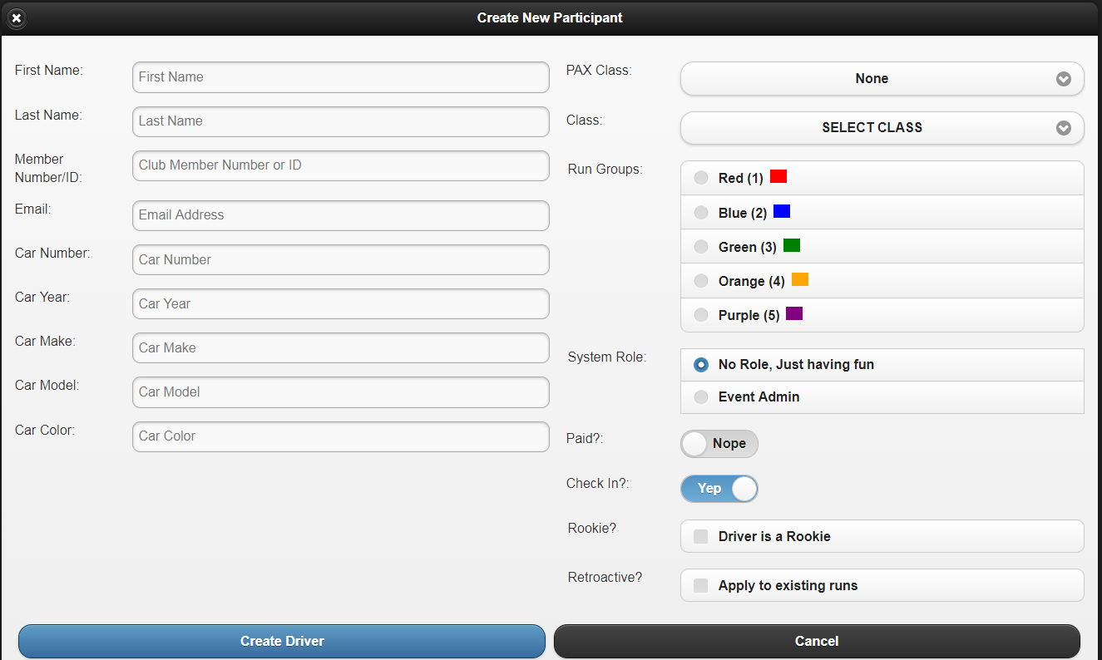
Registration – New Member
Notes:
Make sure you give them a member number!!!!! I always use 111 so I know that I entered it.
Unless FUN
PAX Class needs to be choses if in PAX. It’s possible to avoid it so be careful. For example, I could choose no pax and SM Class when I should have chosen SM-SM.

Slide 24
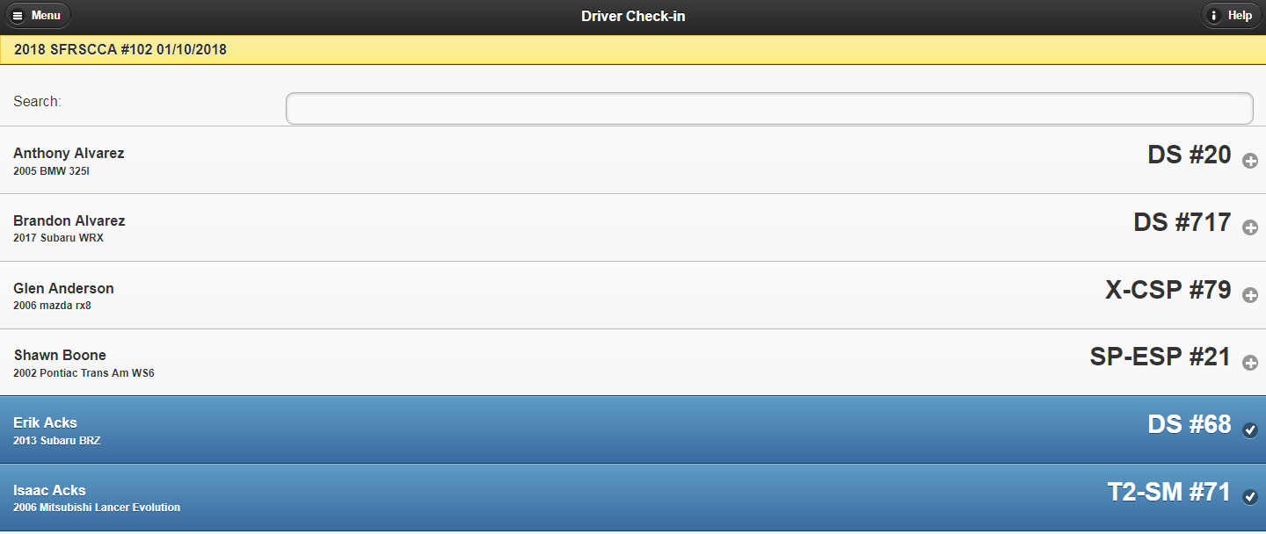
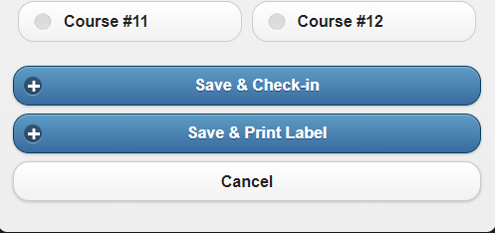
Driver Check-In

Slide 25
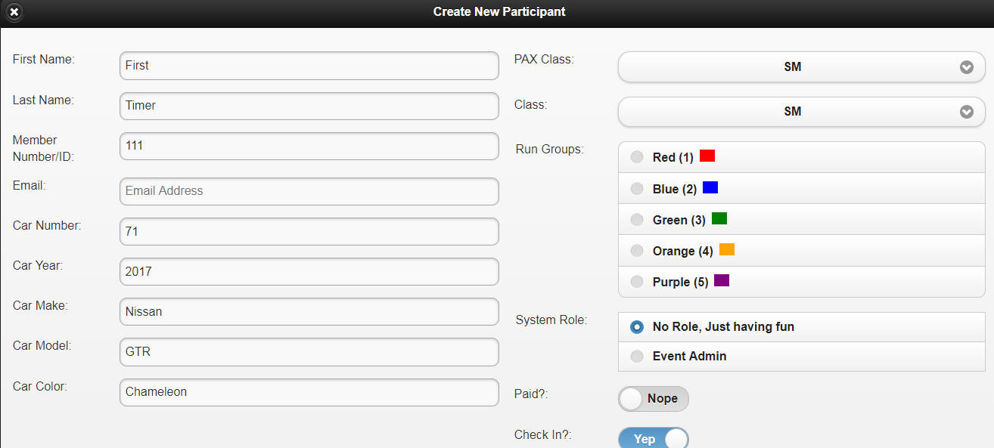
Registration – Conflict
Notes:
Two options.
They pick a new number/class
You get full axtime privilages to modify the member database and remove/change the conflicting entry

Slide 26
Time Keeper
Master of all

Slide 27
Time Keeper
From home page, click on today’s event
Click “Role Login” on top right and login as Event Admin
Click “Time Keeper”

Slide 28
Time Keeper
Your main job is to make sure the times look legitimate and that the most recent car finishing is the right one.
You need to fix any bad times or modify the queue if stuff goes wrong. Do not be afraid to hold the start. If you were off by 1 car at some point, all times are saved anyways. So you can modify 1x1.
Make sure queue is correct and farmtek display is clear before resuming.

Slide 29
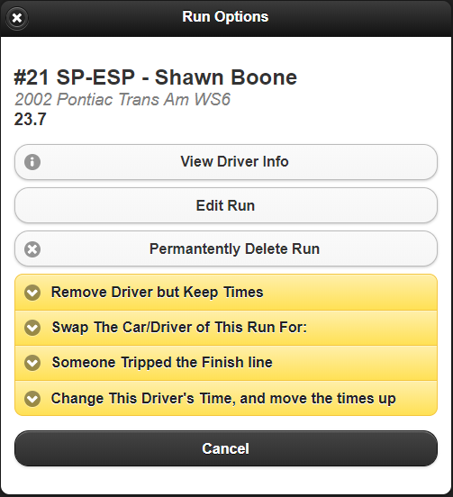
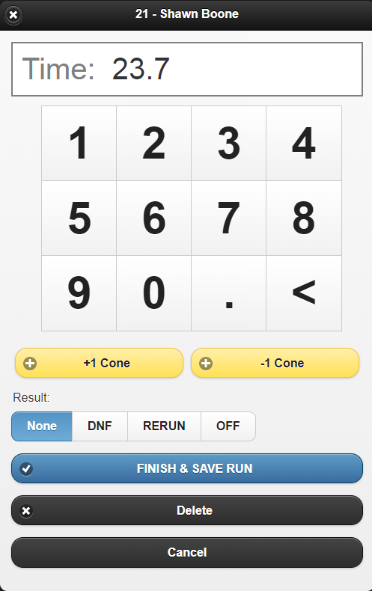
Time Keeper – Fixing Time or Penalizing
Notes:
Change time, add cones, penalize, Finish&Save.
Will push results to Announcer
Do NOT ever do this to a car that’s currently running or in queue. It will finish the car’s run.

Slide 30
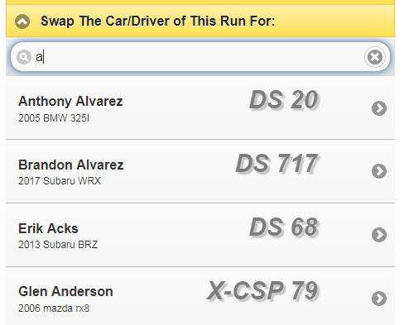
Time Keeper – Swapping Driver
Notes:
Wrong person entered and he/she finished

Slide 31
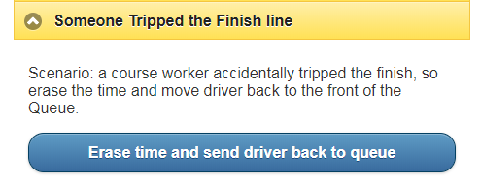
Time Keeper – Course Worker Through Finish
Notes:
Course worker trips finish before car.
Hitting Re-Start on Farmtek SHOULD erase driver’s time and send them from Finished List back to Queue
Just in case it doesn’t actually send them back for whatever reason.

Slide 32
Time Keeper – Car Queuer Missed Someone
Hold the start and let every driver finish
Beginning editing each finished driver one-by-one and give them the appropriate times
Move last driver from finished line back into queue if necessary
Check rest of queue
Start again
Notes:
Situation is you’re off by 1

Slide 33
Time Keeper – End of the Day
From Home Page, click “Recalc Event” to make sure all changes went through
Click “Export”
Click “Export CSV w/Separate Penalty Column”

Slide 34
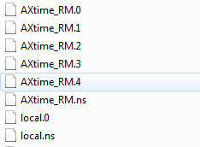
Time Keeper – End of the Day
Copy database files from C:\Axti.me\databases
Notes:
Optional but makes life easier.
Can load up event from home and look at ALL the runs in case there are weird conflicts

